Slide 1
Creating real world User Interfaces with Xamarin.Forms

Slide 2

Who’s this guy?
Harikrishnan
Product Lead – Syncfusion Inc.
harikrishnann@syncfusion.com
https://www.syncfusion.com/products/xamarin

Slide 3
Agenda
✓ Quick overview of Xamarin
✓ Crafting real world applications with Xamarin
✓ Creating real world UI with Syncfusion components
✓ A demo application

Slide 4


Slide 5

Write Once, Run Anywhere

Slide 6
Architecting Mobile Apps

Slide 7
Xamarin’s Unique Approach
iOS C# UI
Android C# UI
Windows C# UI
Shared C# Mobile
Shared C# codebase • 100% native API access • High performance

Slide 8
Xamarin is included
in Visual Studio
Including Community Edition!

Slide 9
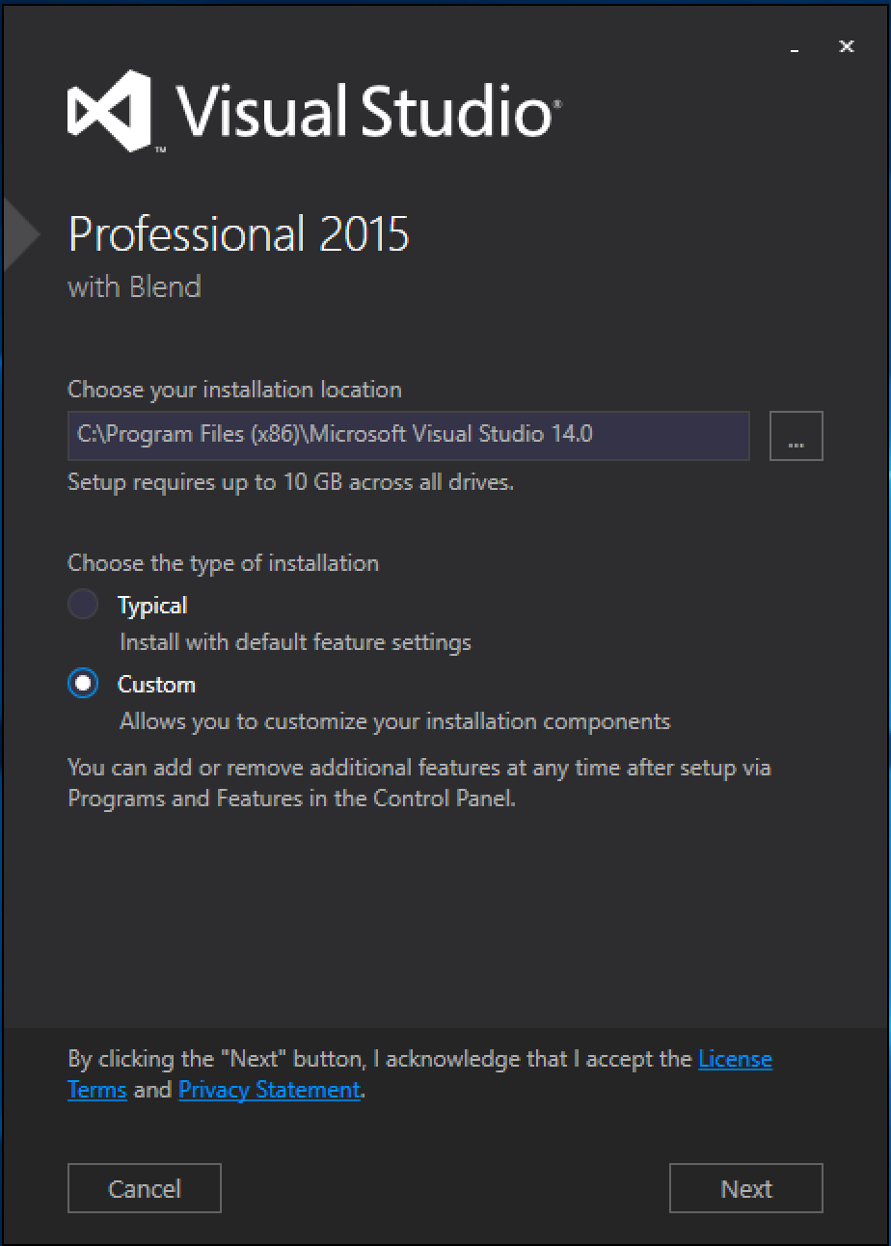
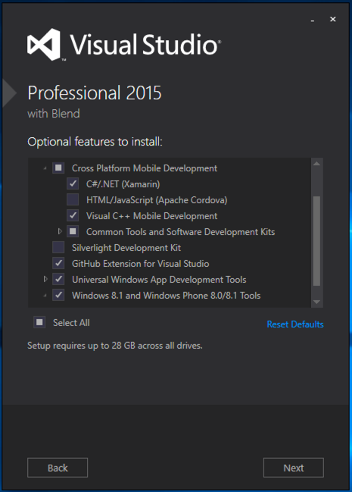
Visual Studio Integration
Xamarin.com/Download

Slide 10
Xamarin is Open Source!
open.xamarin.com

Slide 11
What’s included
✓ 40+ Pages, layouts, and controls
(Build from code behind or XAML)
✓ Two-way data binding
✓ Navigation
✓ Animation API
✓ Dependency Service
Shared UI Code
Shared C# Backend

Slide 12

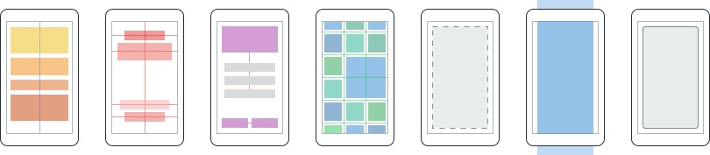
Layouts
Pages
Content
MasterDetail
Navigation
Tabbed
Carousel
Stack
Absolute
Relative
Grid
ContentView
ScrollView
Frame

Slide 13
Controls
ActivityIndicator
BoxView
Button
DatePicker
Editor
Entry
Image
Label
ListView
Map
OpenGLView
Picker
ProgressBar
SearchBar
Slider
Stepper
TableView
TimePicker
WebView
EntryCell
ImageCell
SwitchCell
TextCell
ViewCell

Slide 14
UITextField
Entry
EditText
TextBox

Slide 15
Sharing Code

Slide 16
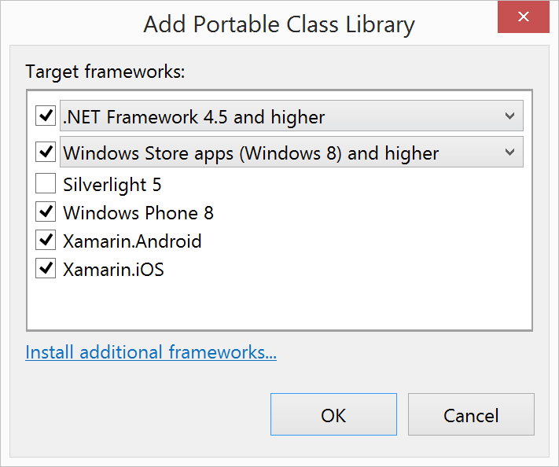
Portable Class Libraries
1 Assembly
Multiple Platforms
Including:
Xamarin.iOS and Xamarin.Android

Slide 17
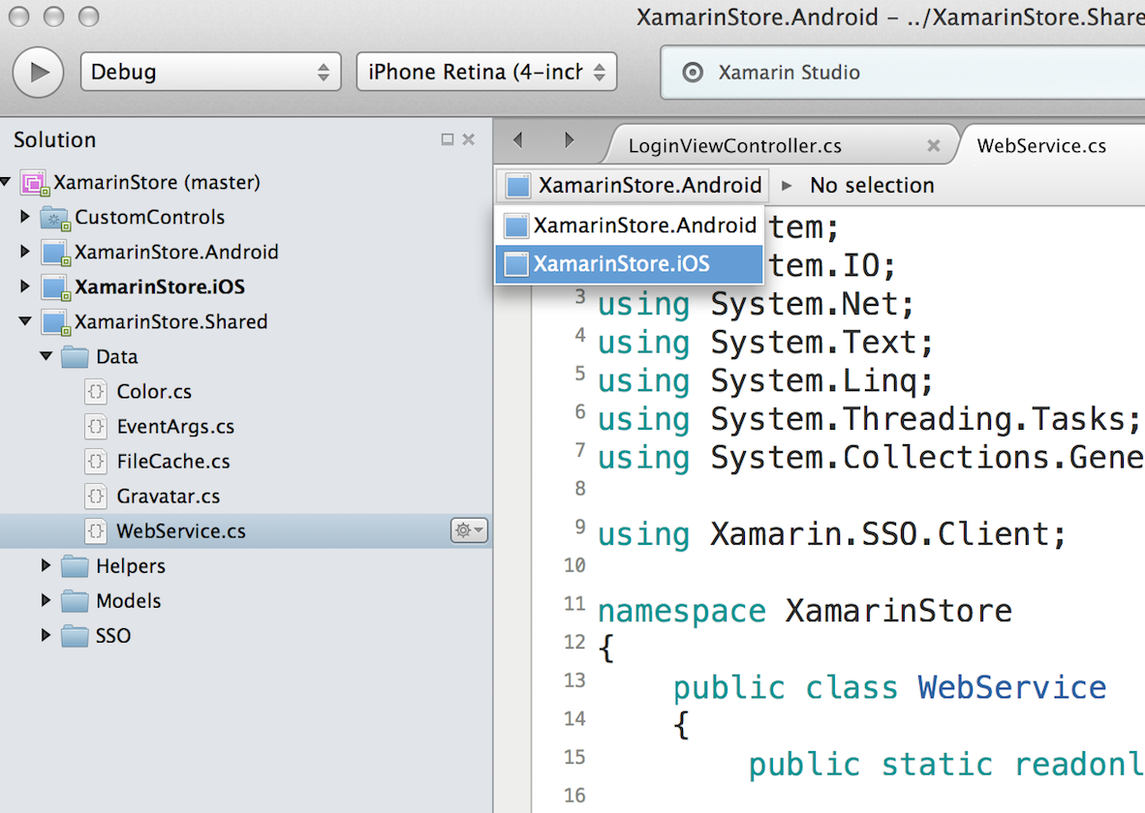
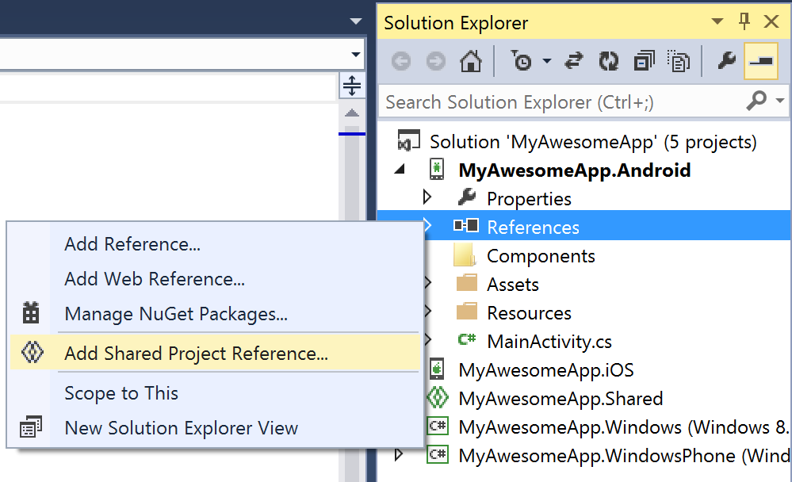
Shared Projects

Slide 18
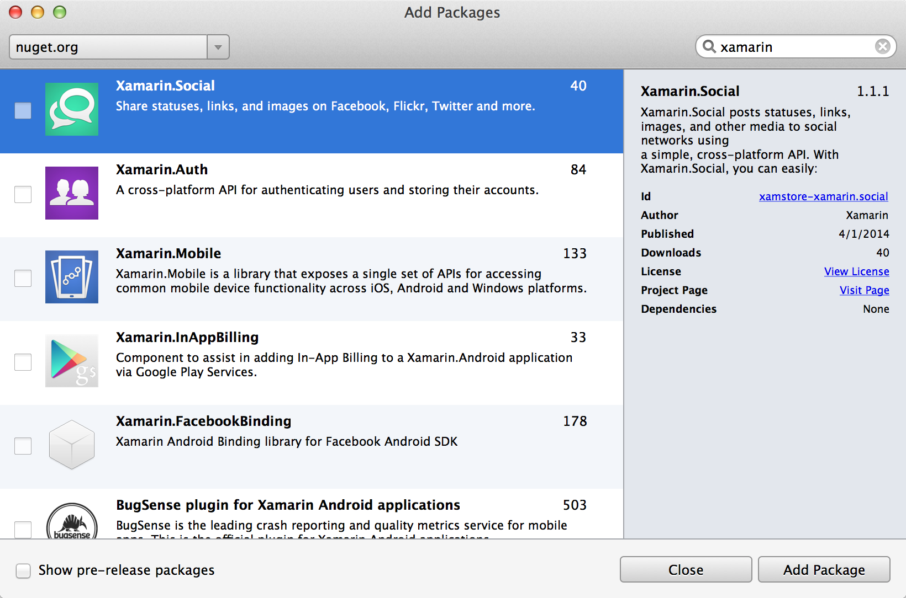
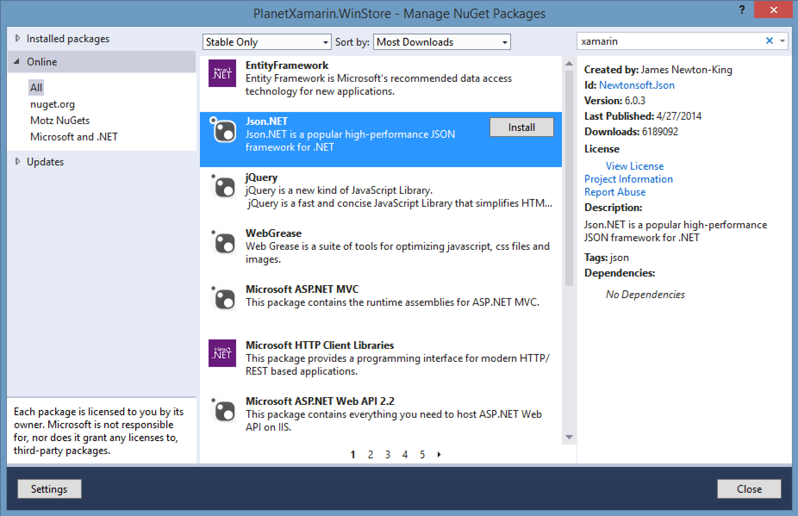
NuGet

Slide 19
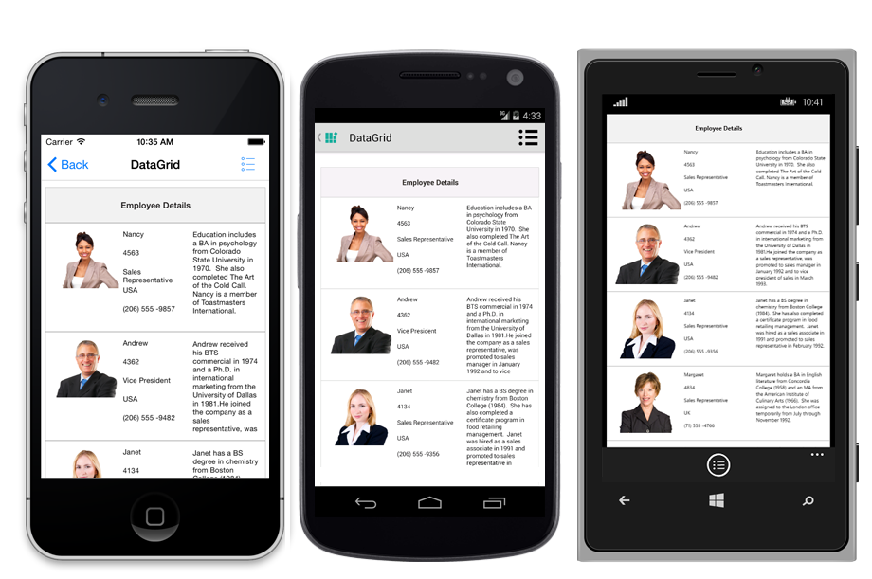
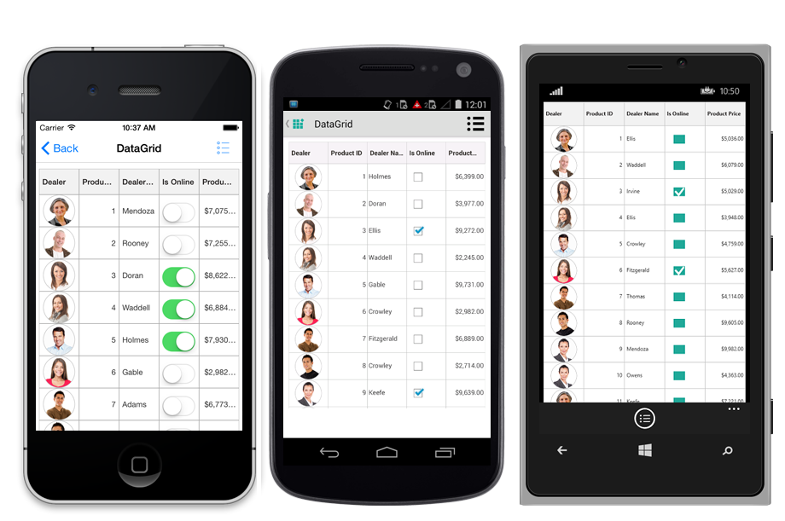
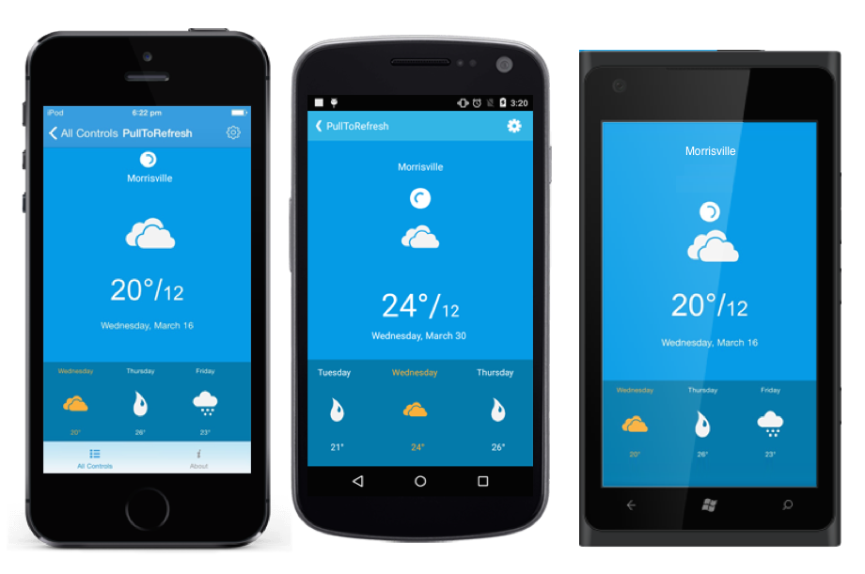
Creating real world UI with Syncfusion components
Stunning data visualization and data bound components
Unique Excel, Word, and PDF manipulations
Full Xamarin.Forms Support
iOS, Android, and Windows
C# or XAML

Slide 20
Let’s Build an App

Slide 21
Demo and Slide document -
https://github.com/harikrishnann/c-sharp_corner_conference
SQLite for Universal Windows Platform
https://marketplace.visualstudio.com/items?itemName=SQLiteDevelopmentTeam.SQLiteforUniversalWindowsPlatform

Slide 22
Thank you ☺
Harikrishnan
Syncfusion Inc.
harikrishnann@syncfusion.com nharishkrish@gmail.com
https://www.syncfusion.com/products/xamarin/datagrid
https://www.linkedin.com/in/hari-krishnan-304a0272

